Slide 1
Delaunay Mesh Generation
Tamal K. Dey
The Ohio State University

Slide 2
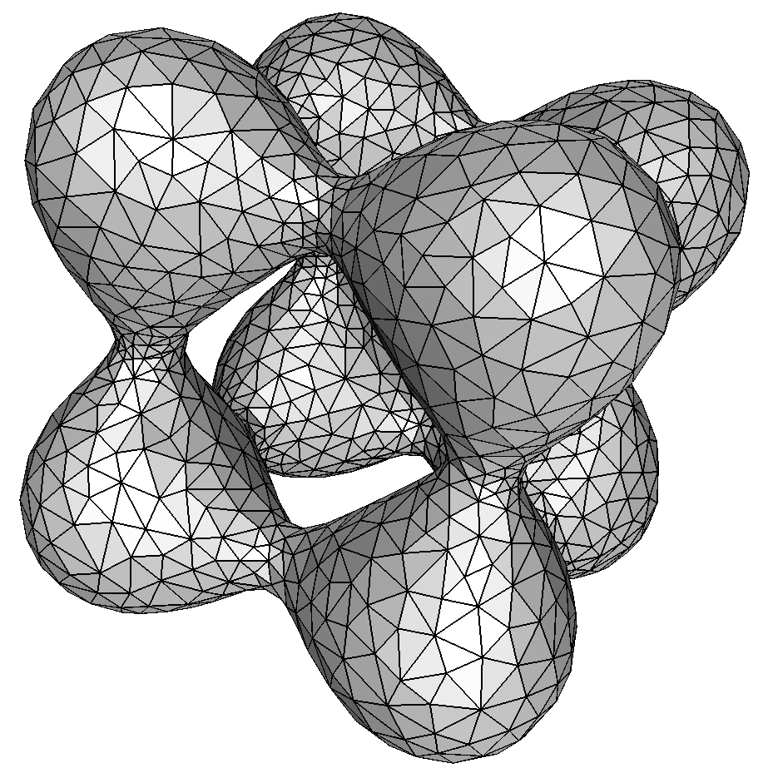

Delaunay Mesh Generation
Automatic mesh generation with good quality.
Delaunay refinements:
The Delaunay triangulation lends to a proof structure.
And it naturally optimizes certain geometric properties.

Slide 3
Basics of Delaunay Refinement
Pioneered by Chew89, Ruppert92, Shewchuck98
To mesh some domain D,
Initialize a set of points S ⊂ D, compute Del S.
If some condition is not satisfied, insert a point c from |D| into S and repeat step 2.
Return Del S.
Burden is to show that the algorithm terminates (shown by a packing argument).

Slide 4
Delsurf =Smooth surface meshing
DelPSC=Delsurf + Protection
=PSC meshing
LocPSC=DelPSC+Localization

Slide 5
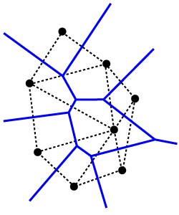
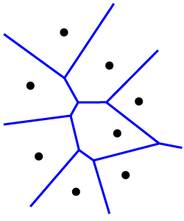
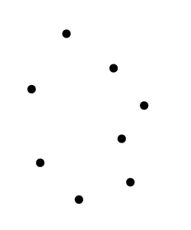
Delaunay Triangulations
For a finite point set S ⊂ R³ let p ∈ S:
Voronoi cell of p:
V_{p} = set of all points in R³ closer to p than any other point in S.
Voronoi k-face:
Intersection of 4-k Voronoi cells.
Voronoi Diagram:
Vor S = collection of all Voronoi faces.
Delaunay j-simplex:
Convex hull of j+1 points which define a Voronoi (3-j)-face.
Delaunay Triangulation:
Del S = collection of Delaunay simplices.

Slide 6
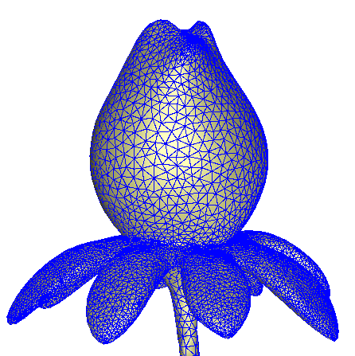
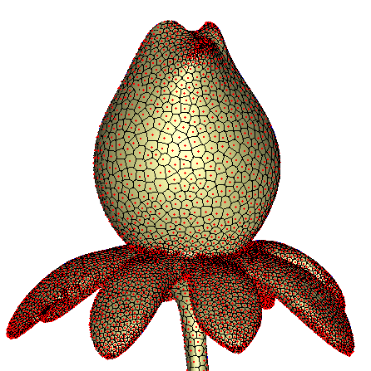
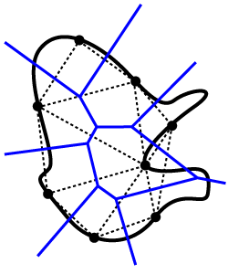
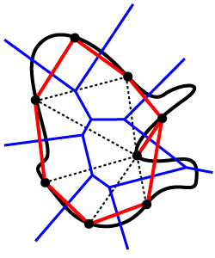
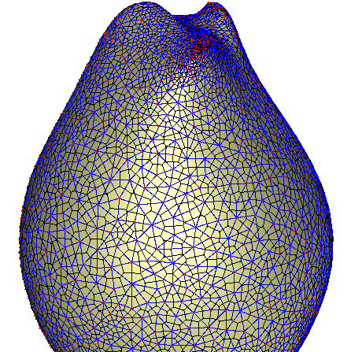
Restricted Delaunay
If the point set is sampled from a domain D.
We can define the restricted Delaunay triangulation, denoted Del S|_{D}.
Each simplex ξ ∈ Del S|_{D} is the dual of a Voronoi face V_{ξ} that has a nonempty intersection with the domain D.
Condition to drive Delaunay refinement often uses the restricted Delaunay triangulation as an approximation for D

Slide 7
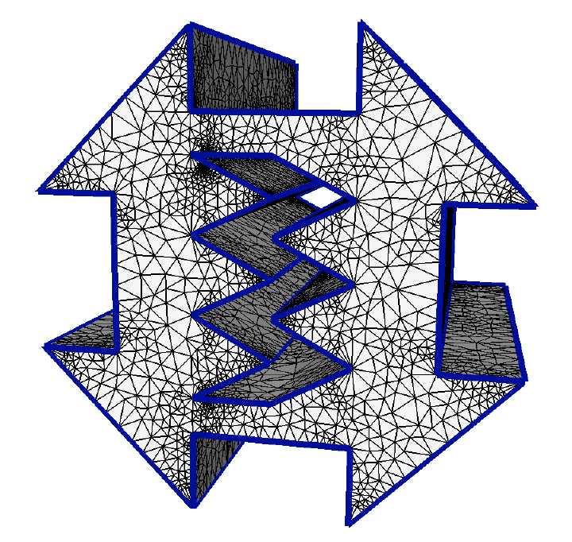
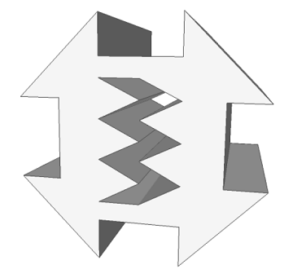
Polyhedral Meshing
Output mesh conforms to input:
All input edges meshed as a collection of Delaunay edges.
All input facets are meshed with a collection of Delaunay triangles.
Algorithms with angle restrictions:
Chew89, Ruppert92, Miller-Talmor-Teng-Walkington95, Shewchuk98.
Small angles allowed:
Shewchuk00, Cohen-Steiner-Verdiere-Yvinec02, Cheng-Poon03, Cheng-Dey-Ramos-Ray04, Pav-Walkington04.

Slide 8
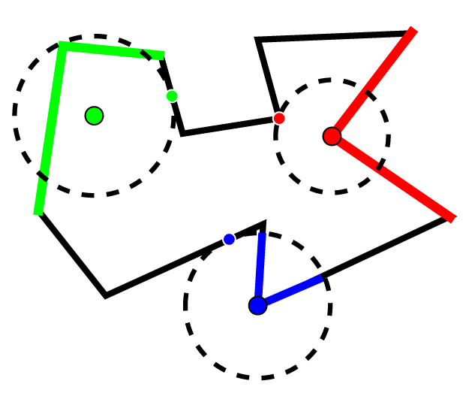
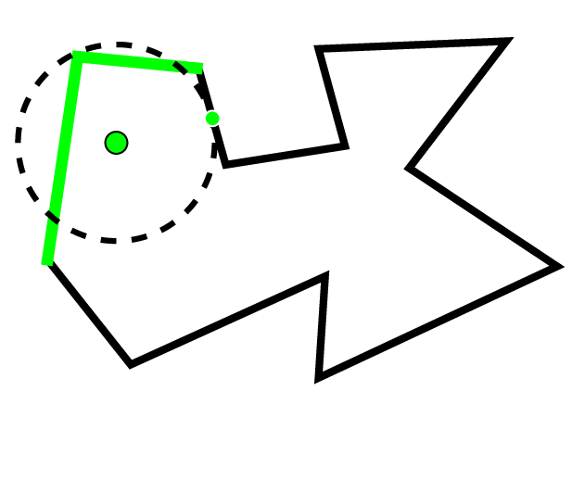
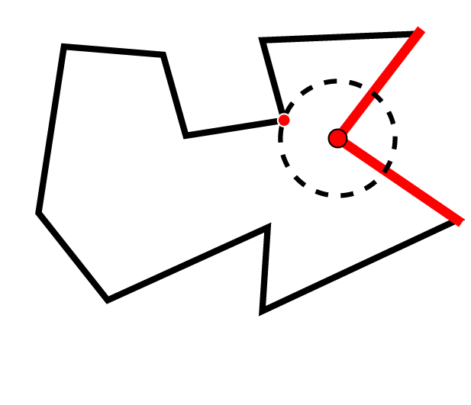
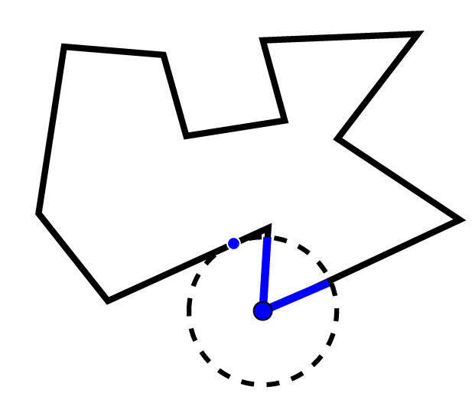
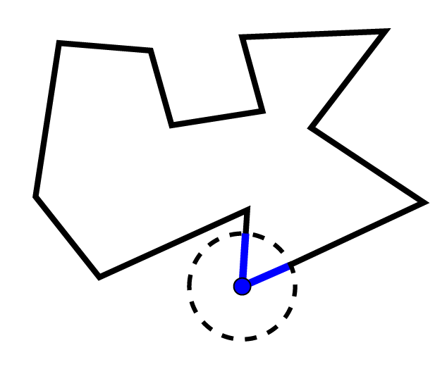
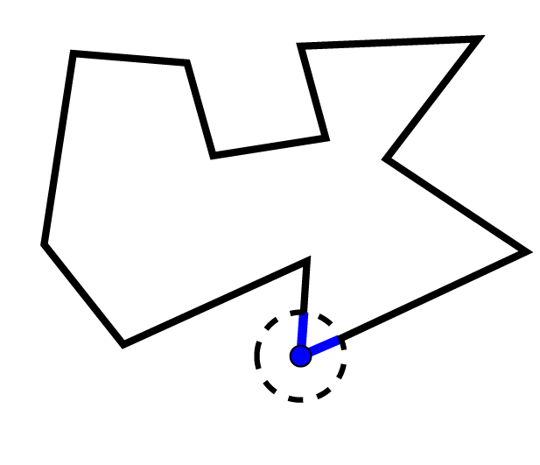
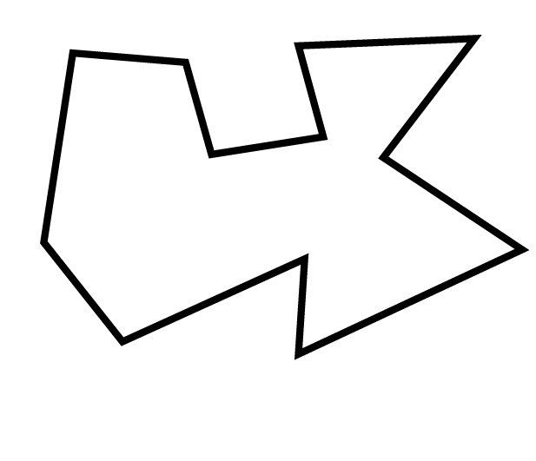
Local Feature Size (Polyhedral)
g(x) = the radius of the smallest ball placed at x which intersects the domain in two disjoint elements pieces.
g(x) is Lipschitz,
|g(x) - g(y)| <= |x - y|.
Termination for polyhedral meshing is shown by a packing argument using this local feature size.

Slide 9
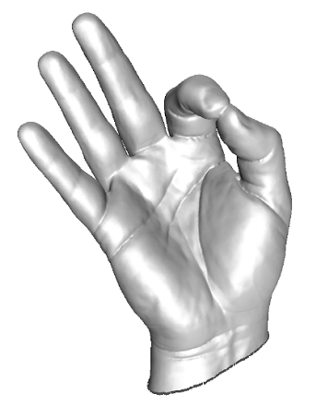
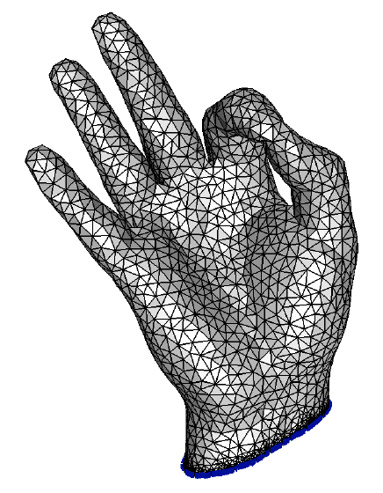
Smooth Surface Meshing
Input mesh is either an implicit surface or a polygonal mesh approximating a smooth surface
Output mesh approximates input geometry, conforms to input topology:
No guarantees:
Chew93.
Skin surfaces:
Cheng-D.-Edelsbrunner-Sullivan01.
Provable surface algorithms:
Boissonnat-Oudot03 and Cheng-D.-Ramos-Ray04.
Interior Volumes:
Oudot-Rineau-Yvinec06.

Slide 10
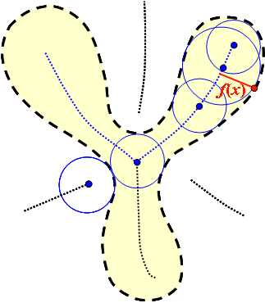
Local Feature Size (Smooth) [ABE98]
Local feature size is calculated using the medial axis of a smooth shape.
f(x) is the distance from a point to the medial axis
S is an ε-sample of D if any point x of D has a sample within distance εf(x).

Slide 11
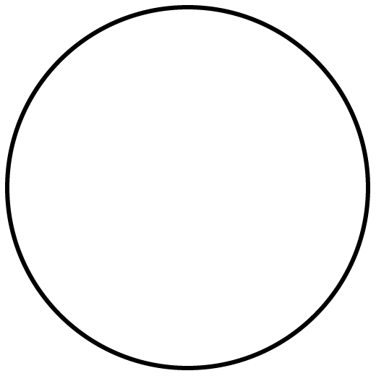
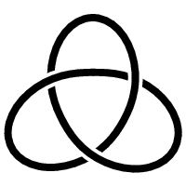
Homeomorphism and Isotopy
Homeomorphsim: A function f between two topological spaces:
f is a bijection
f and f⁻¹ are both continuous
Isotopy: A continuous deformation maintaining homeomorphism
=
≠

Slide 12

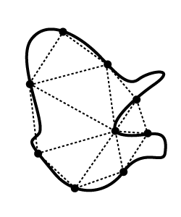
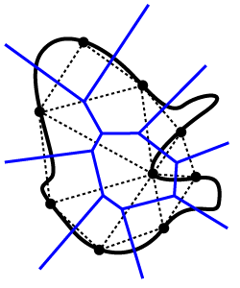
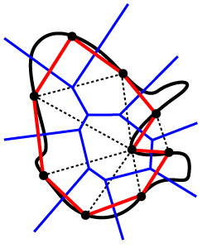
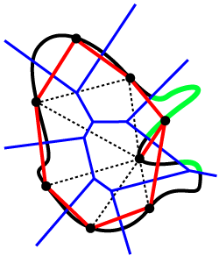
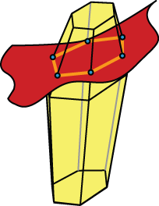
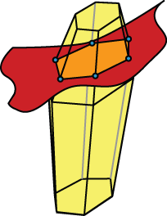
Topological Ball Property (TBP)
S has the TBP for a domain D if each k-face in Vor S either does not intersect D or intersects in a topological (k-1)-ball.
Thm by Edelsbrunner-Shah97 says that if S has the TBP then Del S|_{D} is homeomorphic to D.

Slide 13
Sampling Theorem
Sampling Theorem Modified
Theorem (Boissonat-Oudot 2005):
If S ∈ Μ is a discrete sample of a smooth surface Μ so that each x where a Voronoi edge intersects Μ lies within εf(x) distance from a sample, then for ε<0.09, the restricted Delaunay triangulation Del S|_{Μ} has the following properties:
It is homeomorphic to Μ (even isotopic).
Each triangle has normal aligning within O(ε) angle to the surface normals
Hausdorff distance between Μ and Del S|_{Μ} is O(ε²) of the local feature size.
Theorem:(Amenta-Bern 98, Cheng-Dey-Edelsbrunner-Sullivan 01)
If S ∈ Μ is a discrete ε−sample of a smooth surface Μ, then for ε< 0.09 the restricted Delaunay triangulation Del S|_{Μ} has the following properties:

Slide 14
Basic Delaunay Refinement
Surface Delaunay Refinement
Initialize a set of points S ⊂ Μ, compute Del S.
If some condition is not satisfied, insert a point c from Μ into S and repeat step 2.
Return Del S|_{Μ}.
If some Voronoi edge intersects Μ at x with
d(x,S)> εf(x) insert x in S.

Slide 15
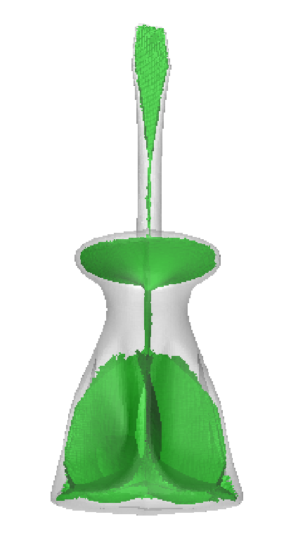
Difficulty
How to compute f(x)?
Special surfaces such as skin surfaces allow easy computation of f(x) [CDES01]
Can be approximated by computing approximate medial axis, needs a dense sample.

Slide 16
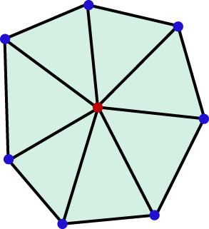
A Solution
Replace d(x,S)< εf(x) with d(x,S)<λ, an user parameter
But, this does not guarantee any topology
Require that triangles around vertices form topological disks [Cheng-Dey-Ramos 04]
Guarantees that output is a manifold

Slide 17
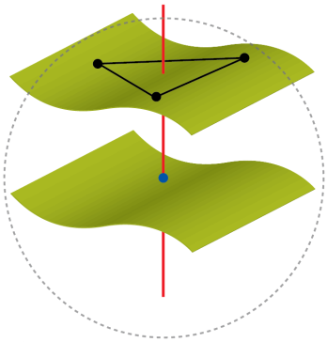
A Solution
Initialize a set of points S ⊂ Μ, compute Del S.
If some Voronoi edge intersects Μ at x with d(x,S)>εf(x) insert x in S, and repeat step 2.
(b)If restricted triangles around a vertex p do not form a topological disk, insert furthest x where a dual Voronoi edge of a triangle around p intersects Μ.
Return Del S|_{M.}
Algorithm DelSurf(Μ,λ)
(a) If some Voronoi edge intersects Μ at x with
d(x,S)> λ insert x in S, and repeat step 2(a).
X=center of largest Surface Delaunay ball
x

Slide 18
A MeshingTheorem
Theorem:
The algorithm DelSurf produces output mesh with the following guarantees:
The output mesh is always a 2-manifold
If λ is sufficiently small, the output mesh satisfies topological and geometric guarantees:
It is related to Μ with an isotopy.
Each triangle has normal aligning within O(λ) angle to the surface normals
Hausdorff distance between Σ and Del S|_{Μ} is O(λ²) of the local feature size.

Slide 19
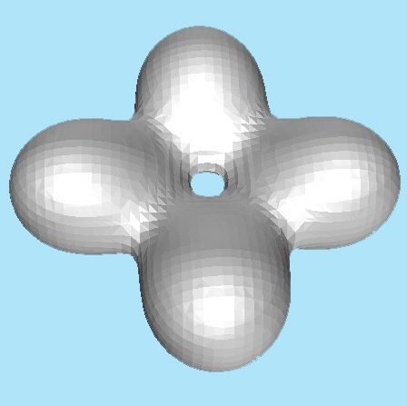
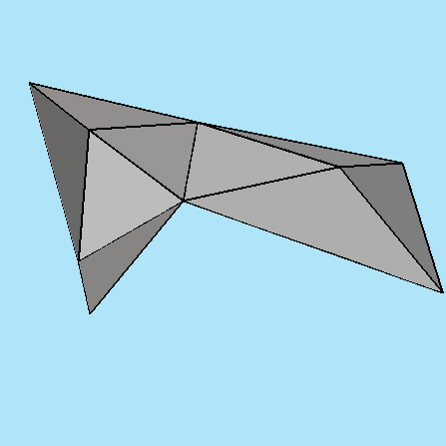
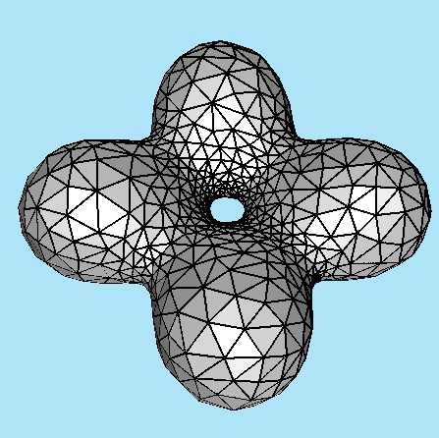
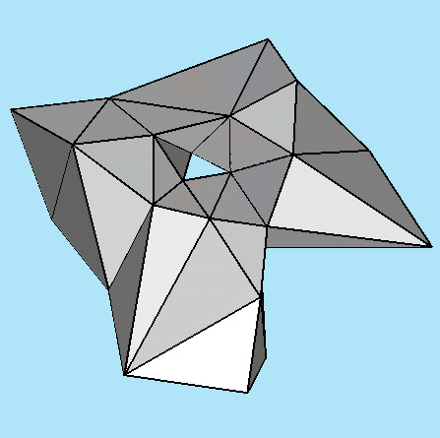
Implicit surface

Slide 20
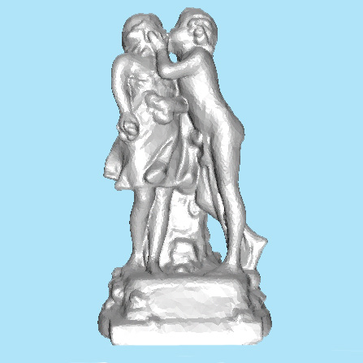
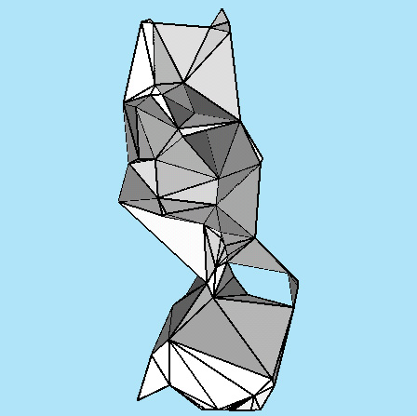
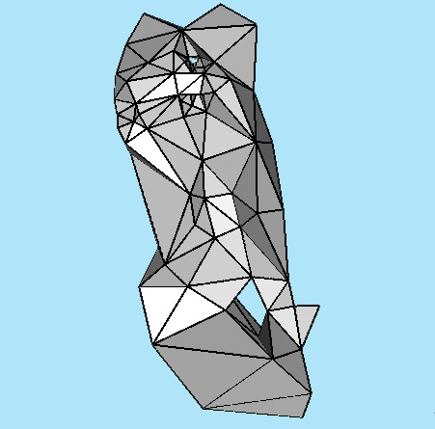
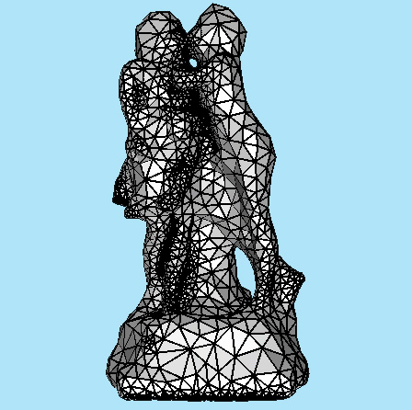
Remeshing

Slide 21


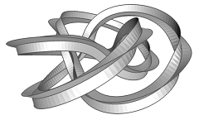
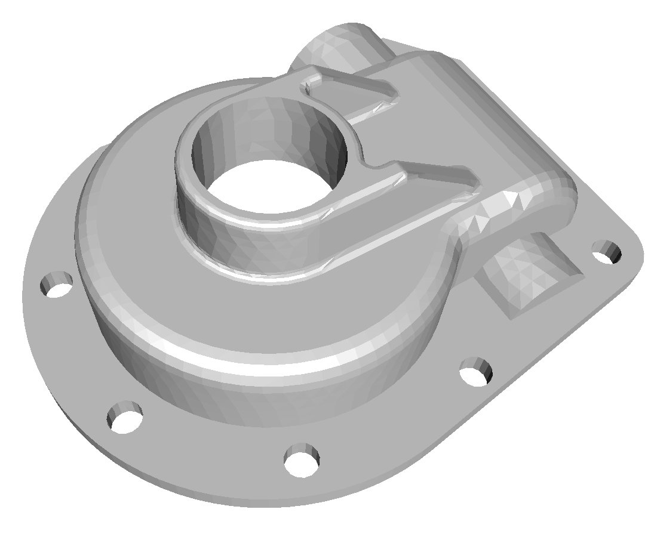
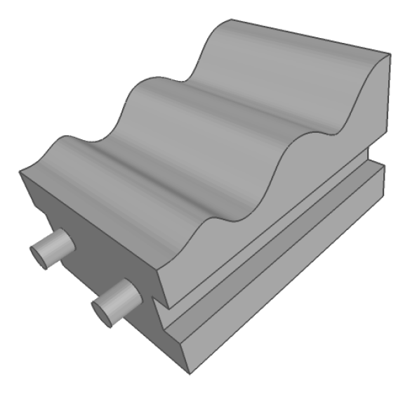
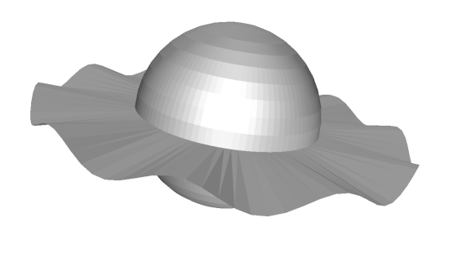
PSCs – A Large Input Class [Cheng-D.-Ramos 07]
Piecewise smooth complexes (PSCs) include:
Polyhedra
Smooth Surfaces
Piecewise-smooth Surfaces
Non-manifolds
&

Slide 22
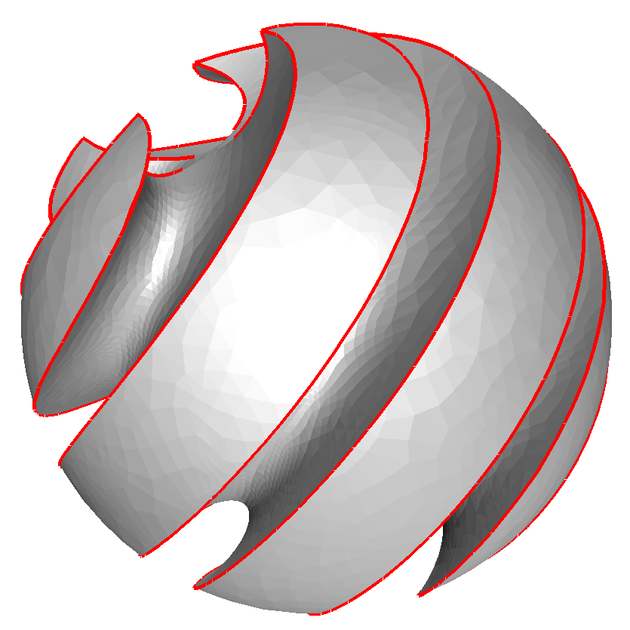
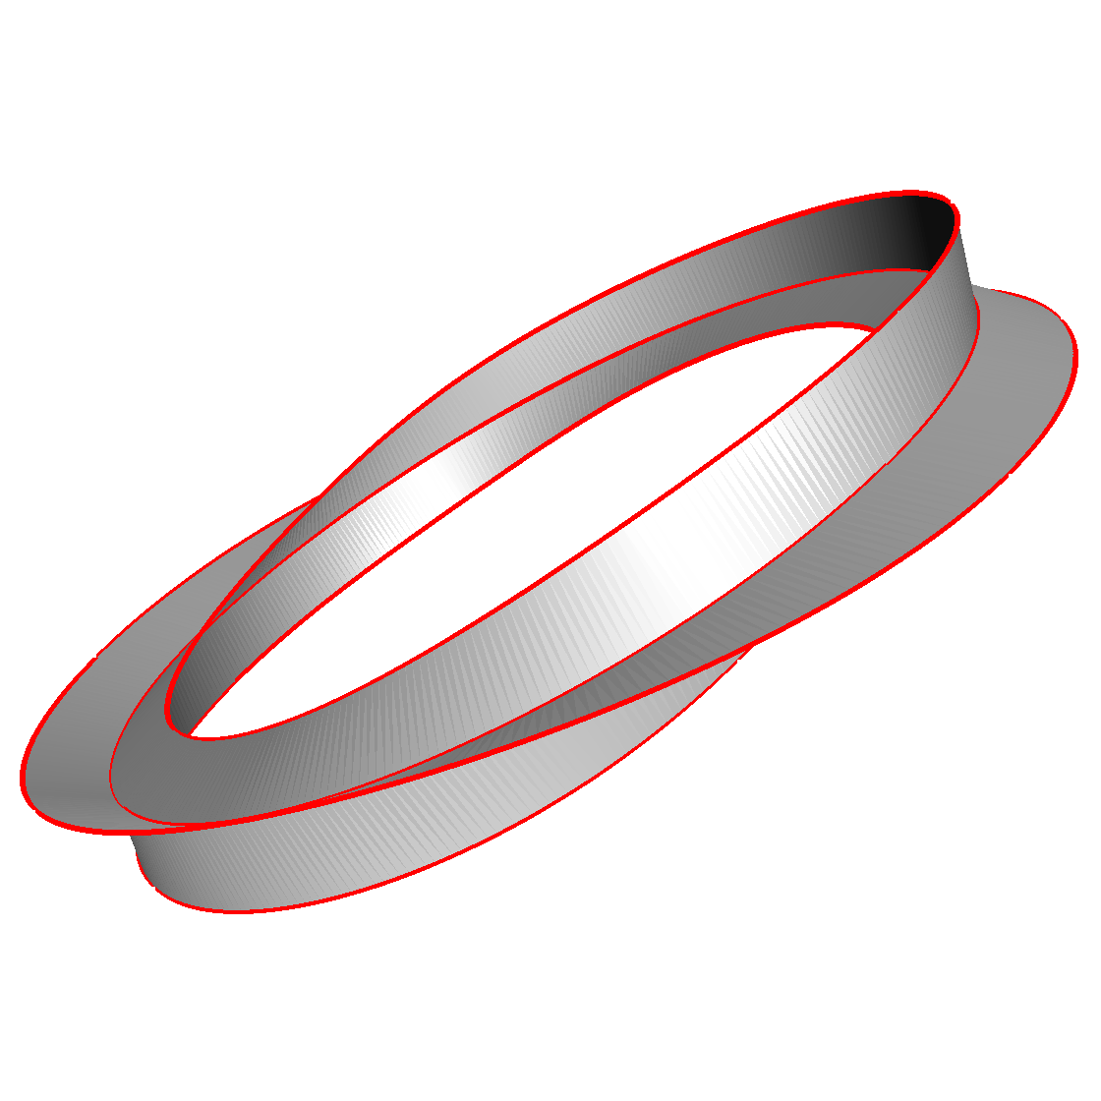
PSCs – A Large Class
A domain D is a PSC if:
Each k-dimensional element is a manifold and compact subset of a smooth (C²) k-manifold, 0≤k≤3.
The k-th stratum, D_{k}, is the set of k-dim elements of D (k-faces).
D satisfies usual reqs for being a complex.
Element interiors are disjoint and for σ ∈ D, bd σ ⊂ D.
For any σ,τ ∈ D, either σ ∩ τ = ∅ or σ ∩ τ ⊂ D .
D₁ is set of elements which are sharp or non-manifold features (highlighted in red)

Slide 23
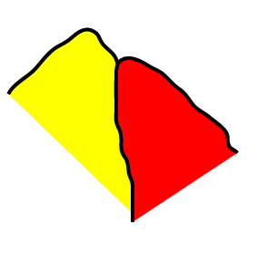
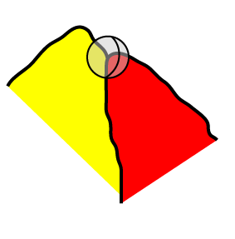
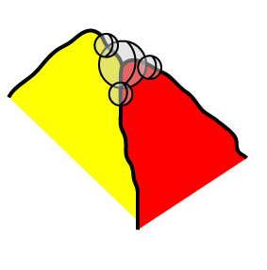
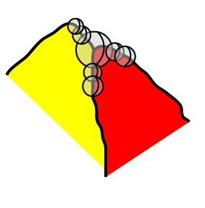




Protecting Ridges
Balls must cover each element of D₁ completely.
Any 2 adjacent balls on a 1-face must overlap significantly without containing each others centers.
No 3 balls should have a common intersection.
(Tangent/Normal Variation) For any point p on a curve, if we look in a small enough region
The portion of the curve nearby p is a single piece.
The tangent along this piece varies a small amount.
The normal of each surface piece adjacent to p also varies little.

Slide 24
Protecting Ridges

Slide 25



A New Disk Condition
Cheng-Dey-Levine use a single topological disk condition:
For a point p on a 2-face σ,
Umb_{D}(p) is the set of triangles incident to p, restricted to D.
Umb_{σ}(p) is the set of triangles incident to p, restricted to σ.
DiskCondition(p) requires:
Umb_{D}(p) = ∪_{σ, p ∈ σ} Umb_{σ}(p)
For each σ containing p, Umb_{σ}(p) is a 2-disk where p is in the interior iff p ∈ int σ
DiskCondition() satisfied

Slide 26
A New Disk Condition
Cheng-Dey-Levine use a single topological disk condition:
For a point p on a 2-face σ,
Umb_{D}(p) is the set of triangles incident to p, restricted to D.
Umb_{σ}(p) is the set of triangles incident to p, restricted to σ.
DiskCondition(p) requires:
Umb_{D}(p) = ∪_{σ, p ∈ σ} Umb_{σ}(p)
For each σ containing p, Umb_{σ}(p) is a 2-disk where p is in the interior iff p ∈ int σ
DiskCondition() satisfied

Slide 27
Delsurf
+ Protection
= DelPSC

Slide 28
DelPSC Algorithm [Cheng-D.-Ramos-Levine 07,08]
DelPSC(D, λ)
Protect ridges of D using protection balls.
Refine in the weighted Delaunay by turning the balls into weighted points.
Refine a triangle if it has orthoradius > λ
Refine a triangle or a ball if disk condition is violated
Refine a ball if it is too big (with respect to λ)
Return ∪_{i} Del^{i} S|_{Di}

Slide 29


Guarantees for DelPSC
Manifold
For each σ ∈ D₂, triangles in Del S|_{σ} are a manifold with vertices only in σ. Further, their boundary is homeomorphic to bd σ with vertices only in σ.
Granularity
There exists some λ > 0 so that the output of DelPSC(D, λ) is homeomorphic to D.
This homeomorphism respects stratification, For 0 ≤ i ≤ 2, and σ ∈ D_{i}, Del S|_{σ} is homemorphic to σ too.

Slide 30






Reducing λ

Slide 31




Examples

Slide 32




Examples

Slide 33




Examples

Slide 34





Examples

Slide 35
Delsurf
+ Protection
+ Localization

Slide 36

Delaunay Refinement Limitations
Traditional refinement maintains Delaunay triangulation in memory
This does not scale well
Causes memory thrashing
May be aborted by OS

Slide 37
Localization
A simple algorithm that avoids the scaling issues of the Delaunay triangulation
Avoids memory thrashing
Topological and geometric guarantees
Guarantee of termination
Potentially parallelizable

Slide 38



A Natural Solution
Use an octree T to divide S and process points in each node v of T separately

Slide 39

Two Concerns
Termination
Mesh consistency

Slide 40

Termination Trouble
A locally furthest point in node v can be very close to a point in other nodes

Slide 41

Messing Mesh Consistency
Individual meshes do not blend consistently across boundaries

Slide 42

LocDel Algorithm: Overview
Process nodes from a queue Q
Refines nodes with parameter λ if there are violations

Slide 43
Splitting and reprocessing ν
Split
Let S_{ν} = ν ∩ S
Split ν into eight children if ||S_{ν}||> κ
Reprocess ν

Slide 44



Splitting ν

Slide 45

Refining node ν
Augment
Assemble R_{ν}=N_{ν}US_{ν}
Compute Del R_{ν}|_{M}
Refine
Surface Delaunay ball larger than λ
F_{p} ⊆ Del R_{ν}|_{M} is not a disk

Slide 46
Returned points for violations
Checking Violations
Large triangle t incident to p ϵ S_{ν}
Radius of surface ball > λ
Return (p,p*) where p* is furthest dual(t) ∩ M
Non-disk surface star F_{p}
Return (p,p*) where p* is the furthest dual(t) ∩ M among all triangles

Slide 47

Modified Point Insertions
Modified insertion strategy
If nearest point s ϵ S to p* is within λ/8 and s ≠ p, then add s to R_{ν}
Else add p* to R_{ν}
p* augments S, but s does not

Slide 48

Point insertions

Slide 49

Reprocessing nodes for Consistency
Needed for mesh consistency
Suppose s is added
Enqueue each node ν' ≠ ν s.t. d(s, ν') ≤ 2λ

Slide 50

Maintaining light structures
For each node ν keep:
S_{ν} = S ∩ ν
U_{p ϵ Sν} F_{p}
Output: union of surface stars U_{p ϵ S} F_{p}

Slide 51
Termination
insertions are finite, so are enqueues and splits
Augmenting R_{ν} by an existing point does not grow S
Consider inserting a new point s
Nearest point ≠ p → at least λ/8 from S
Insertion due to triangle size → at least λ from S
Else → at least ε_{M} from S by our result in Voronoi point sampling:

Slide 52
Termination
Proposition [Cheng-Dey-Ramos-Ray 2007]:
∃ ε_{M}>0 s.t. if intersections of all edges of V_{p} with M lie within ε_{M} of p then F_{p} forms a topological disk

Slide 53
Mesh Theorem for Localization
Theorem:
output mesh is a 2-manifold without boundary for any λ.
Each point in the output is within distance λ of M
∃ λ*>0 s.t. if λ<λ* the output is isotopic to M with Hausdorff distance of O(λ²)

Slide 54

Manifoldness
We require surface stars to fit together globally
Consistency condition: In the output complex U_{p}F_{p}, a triangle abc is in F_{a} if and only if it is also in F_{b} and F_{c}

Slide 55

Manifoldness
Theorem: At termination UF_{p} ⊆ Del S|_{M}
Consider the last time ν is processed; t in ν
Size condition → t in Del S|_{M} when ν is done
If t ∉ Del S|_{M} afterward, there is a point s in Delaunay ball. But, s causes ν to be reprocessed

Slide 56
Topology
For sufficiently small λ sampling theorem for restricted Delaunay holds which is output.

Slide 57

Results
Varying κ does not change the mesh qualitatively

Slide 58

Results
Optimal κ is platform-dependent

Slide 59

Results

Slide 60

Results

Slide 61

Results

Slide 62

Localized Volume Meshing (SGP 2011)
Extension of LocDel to volume meshing
Leverage existing results for proofs
Dey-Levine-Slatton 10
Oudot-Rineau-Yvinec 05
We prove
Termination
Geometric closeness of output to input
For small λ:
Output is isotopic to input
Hausdorff distance O(λ²)

Slide 63

LocVol

Slide 64
LocVol

Slide 65
Conclusions
Localized versions with certified geometry and topology
Localized versions for PSCs [D.-Slatton13]
Software available from http://www.cse.ohio-state.edu/~tamaldey/surfremesh.html
http://www.cse.ohio-state.edu/~tamaldey/delpsc.html
http://www.cse.ohio-state.edu/~tamaldey/locpsc.html
Acknowledgement: NSF, CGAL
A book Delaunay Mesh Generation: S.-W. Cheng, T. Dey, J. Shewchuk (2012)

Slide 66
Thank You!

